Slide 1
What is bullying?
Secondary school lesson

Slide 2
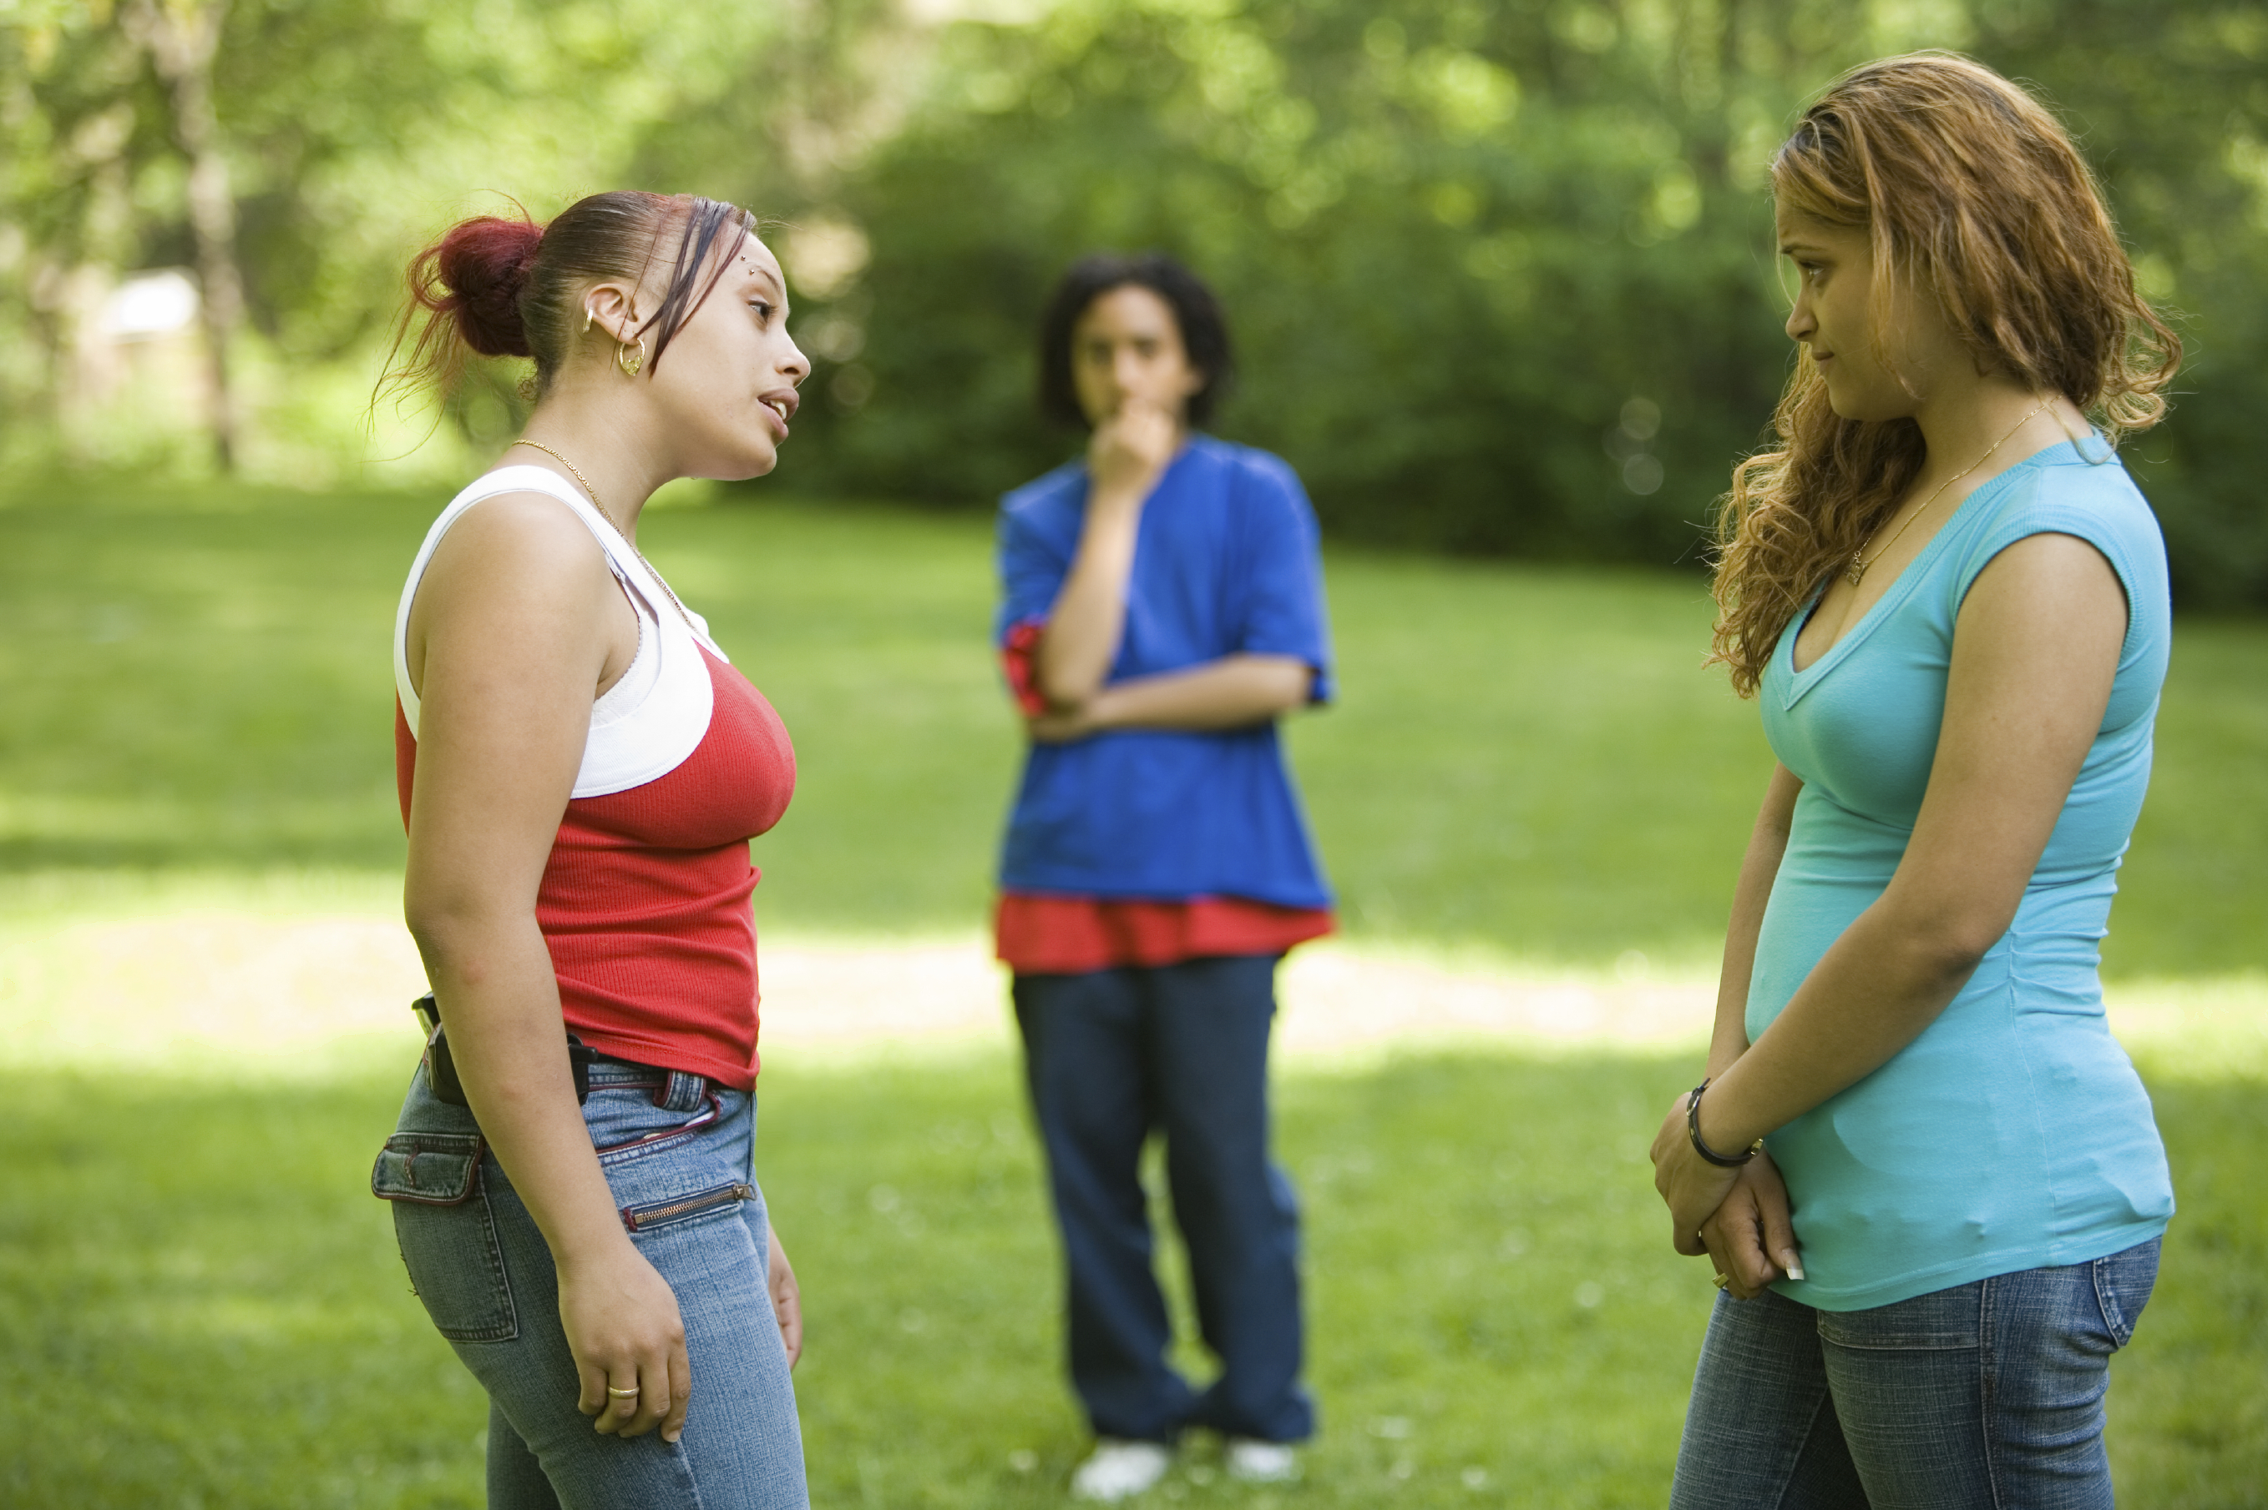
Challenging bullying
Bullying affects millions of lives and can leave us feeling hopeless. But if we challenge it, we can change it. And it starts by reaching out.
It doesn’t stop with young people. From teachers to parents and influencers to politicians, we all have a part to play. Reach out to someone you trust if you need to talk. Reach out to someone if you know they’re being bullied. Reach out by being the change you want to see.
It takes courage, but it can change lives.

Slide 3
What is bullying?
‘The repetitive,
intentional hurting of one person or group by another person or group, where the relationship involves an imbalance of power. Bullying can be physical, verbal or psychological. It can happen face-to-face or online’.
The ABA (Anti-Bullying Alliance) defines bullying as:
Power imbalance
Repetitive
Hurtful
Intentional

Slide 4
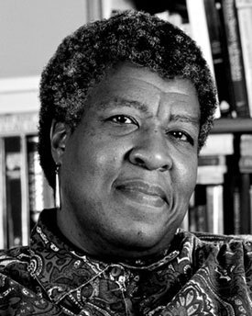
Discussion:
Not everyone has been a bully or the victim of bullies, but everyone has seen bullying, and seeing it, has responded to it by joining in or objecting, by laughing, or keeping silent, by feeling disgusted or feeling interested.
- Octavia E. Butler

Slide 5
The impact of bullying
https://youtu.be/tz_FTV3EZRM?si=qdDwb4jPgO7pqu-Z

Slide 6
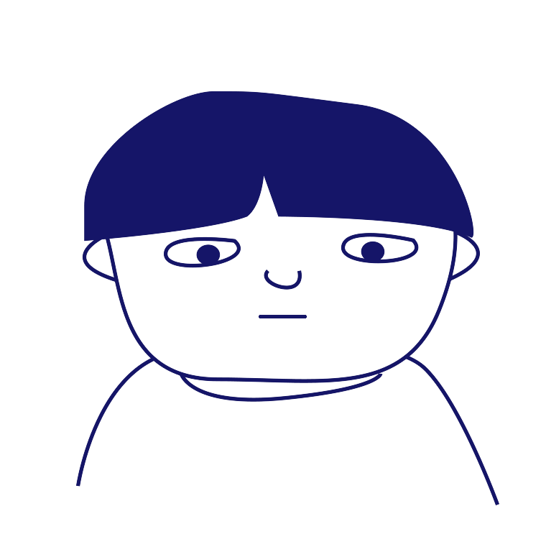
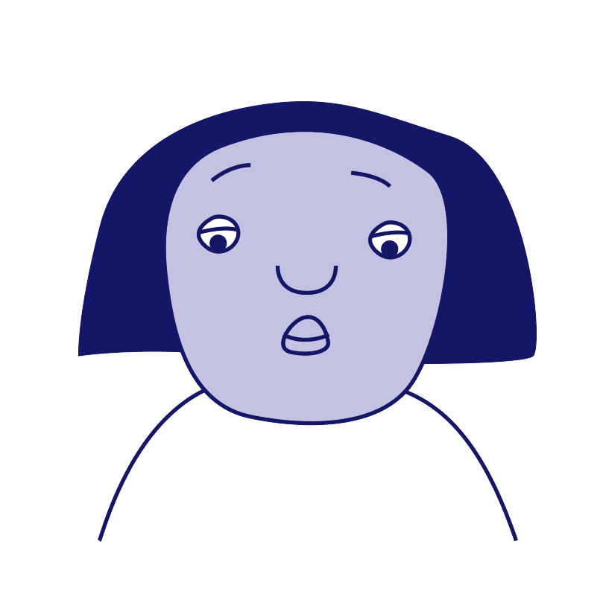
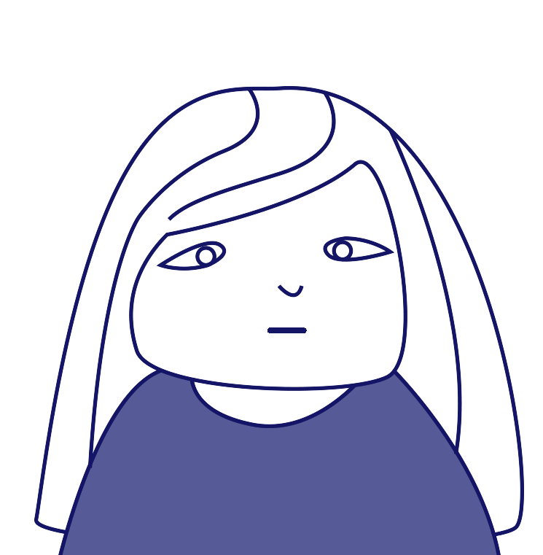
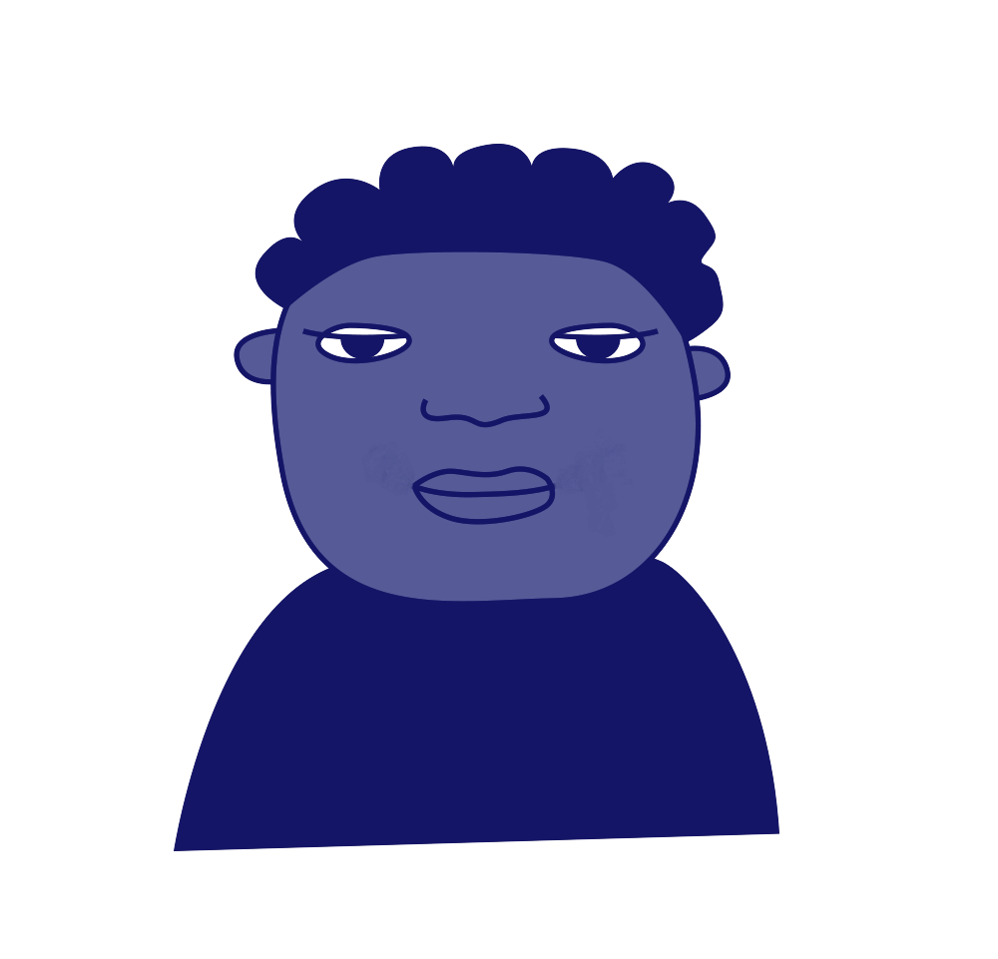
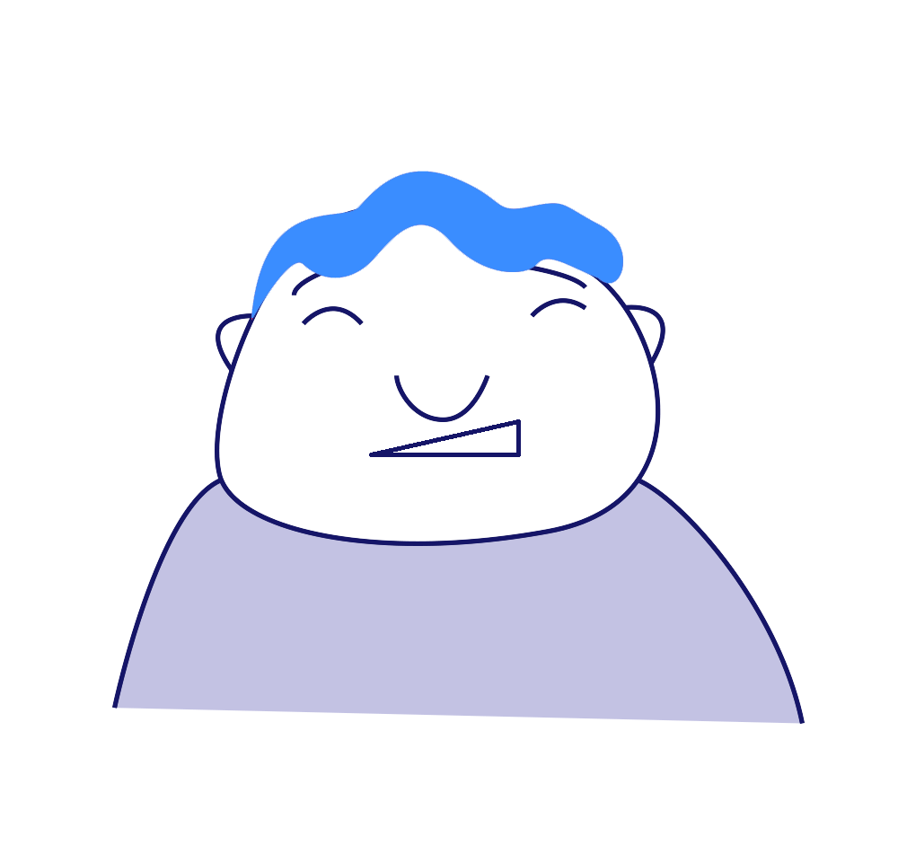
Roles involved in bullying
‘Ringleader’
‘Target’
‘Assistant’
‘Outsider’ or
Bystander’
‘Defender’
‘Reinforcer’
Notes:
The ringleader (Bully) - Initiating and leading the bullying but not always the person ‘doing’ the bullying.
The target - The person at whom the bullying is aimed.
Assistant(s) - Actively involved in ‘doing’ the bullying but not leading it
Reinforcer(s) - Supports the bullying, might laugh or encourage other people to ‘collude’
Defender(s) - Stands up for someone being bullied. Knows that bullying is wrong and feels confident enough to do something about it. This might involve talking to an adult.
Outsider/Bystander(s) - Ignores any bullying and doesn’t want to get involved.
These roles are constantly shifting depending on who is present and the dynamics in the group.
The salient points are discussed in this video taken from our online training, which you as a facilitator might find useful: https://youtu.be/-h28qPIxQvA.

Slide 7
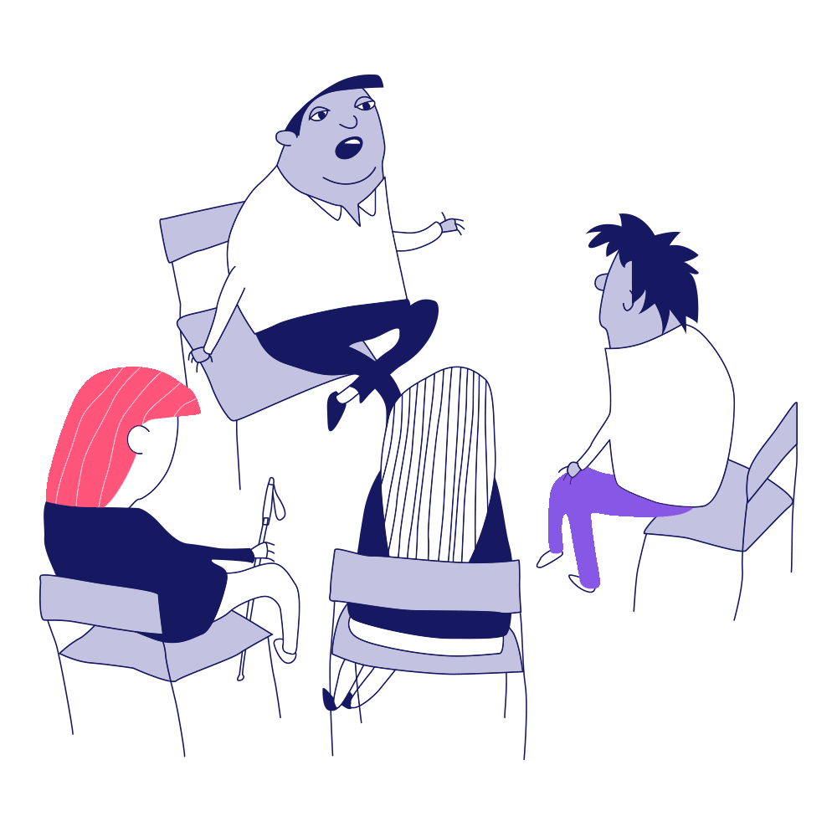
Group discussion
?
How can our school community help students reach out and talk about bullying?

Slide 8
Who can we reach out for support to in our school?
Staff Name here
Staff Name here
Staff Name here
1
2
3

