Slide 1
What is bullying?
Secondary school assembly

Slide 2
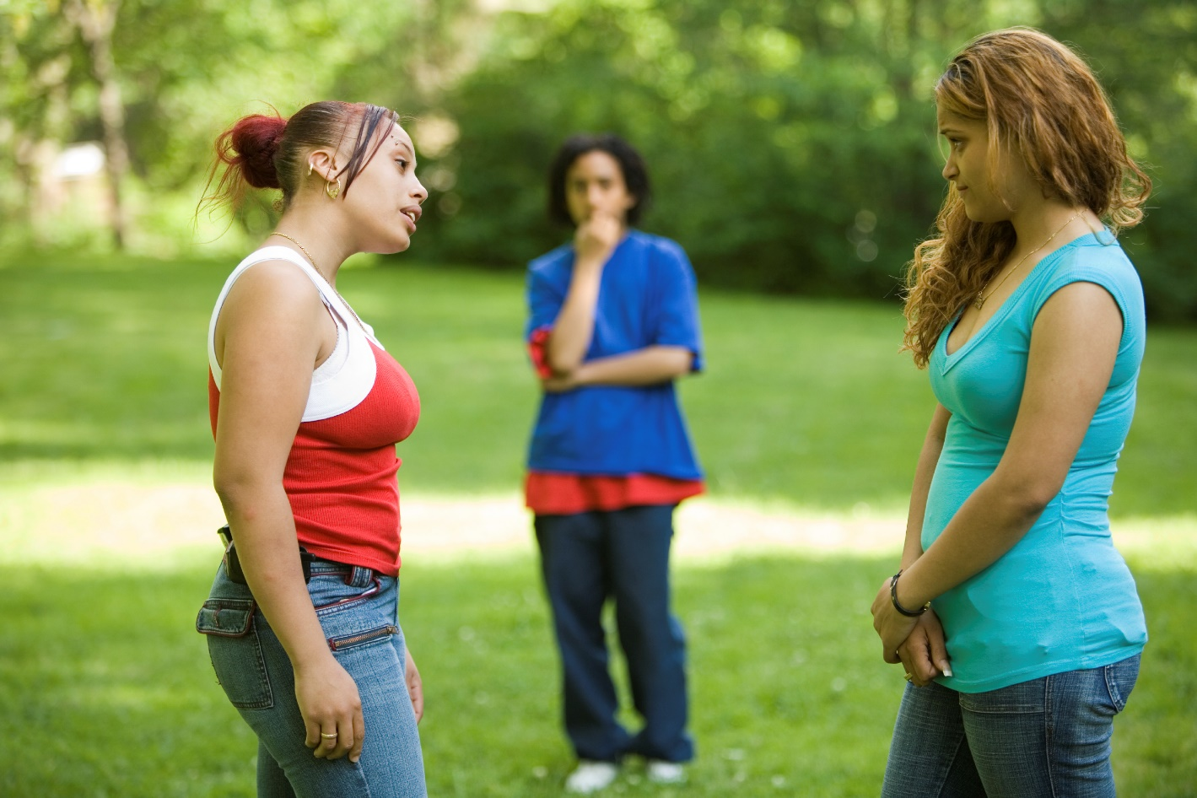
Challenging bullying
Bullying affects millions of lives and can leave us feeling hopeless. But if we challenge it, we can change it. And it starts by reaching out.
It doesn’t stop with young people. From teachers to parents and influencers to politicians, we all have a part to play. Reach out to someone you trust if you need to talk. Reach out to someone if you know they’re being bullied. Reach out by being the change you want to see.
It takes courage, but it can change lives.

Slide 3
What is bullying?
‘The repetitive,
intentional hurting of one person or group by another person or group, where the relationship involves an imbalance of power. Bullying can be physical, verbal or psychological. It can happen face-to-face or online’.
The ABA (Anti-Bullying Alliance) defines bullying as:
Power imbalance
Repetitive
Hurtful
Intentional

Slide 4
Types of bullying
Physical
Verbal
Includes hitting, kicking, tripping, pushing or purposefully damaging other people’s property.
Includes name-calling, threatening, teasing, saying nasty or rude things to someone.
Psychological
Online
Includes spreading lies about someone, playing nasty jokes or excluding people.
Includes hurtful comments/messages/posts, excluding on purpose, spreading nasty gossip and imitating others online.

Slide 5
Talking about bullying
Two times you have reached out to someone in need
1
Take a moment to consider…
Two times someone has reached out to you when you needed help
2

Slide 6
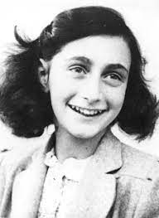
Let’s reflect:
How wonderful it is that no one has to wait, but can start right now to gradually change the world
- Anne Frank

Slide 7
Who can we reach out for support to in our school?
Staff Name here
Staff Name here
Staff Name here
1
2
3

