Slide 1
What is bullying?
Primary school assembly

Slide 2
What is bullying?
https://youtu.be/U8iX-rstY9I?si=xBiq7isqvbbvOdod

Slide 3
What is bullying?
‘The repetitive,
intentional hurting of one person or group by another person or group, where the relationship involves an imbalance of power. Bullying can be physical, verbal or psychological. It can happen face-to-face or online’.
The ABA (Anti-Bullying Alliance) defines bullying as:
Power imbalance
Repetitive
Hurtful
Intentional

Slide 4
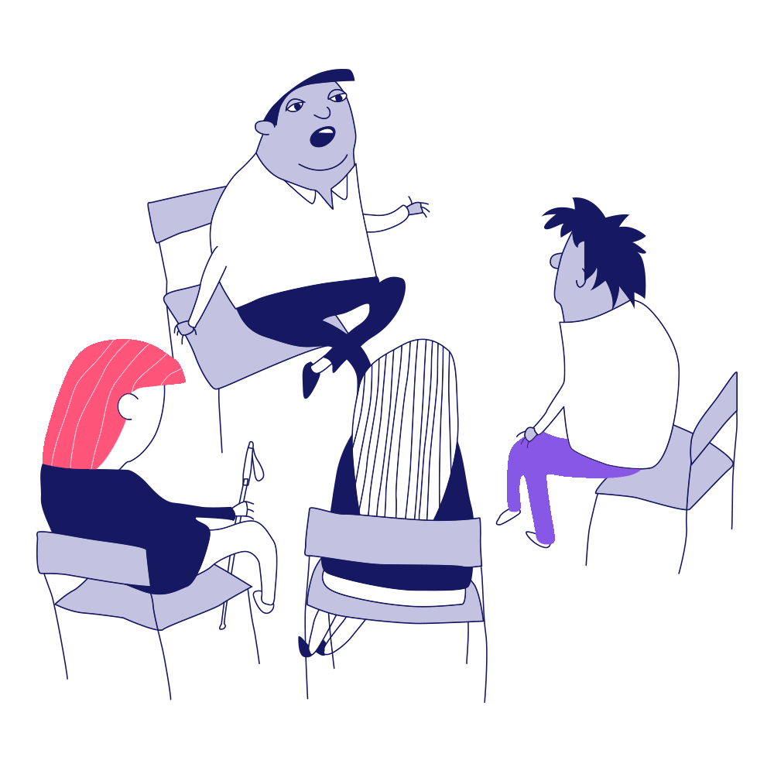
Talking about bullying
Friends?
1
How can we talk about bullying with others?
Teachers and school staff?
2
Parents and carers?
3
Yourselves?
4

Slide 5
Who can we reach out for support to in our school?
Staff Name here
Staff Name here
Staff Name here
1
2
3

