Slide 1
I’m Still Me!
LGBT inclusive practices

Slide 2
Which British Value/s should we consider when looking at LGBT inclusion in schools?

Slide 3
The History of LGBT+ rights in the UK
2002
Equal rights for same sex couples to adopt
1972
First UK Pride march
1988
Section 28
2004
Recognise
trans in law
2003
Employment rights for LGB people
2003
Repeal of section 28
2019
New statutory guidance passed on SRE
2006
Goods and services discrimination
2013
Equal rights to marriage

Slide 4
The History of LGBT+ rights in the UK
• It was brought in to ‘prohibit the promotion of homosexuality by local authorities’
• Tory Prime Minister Margaret Thatcher said at the time: ‘Children who need to be taught to respect traditional moral values are being taught that they have an inalienable right to be gay. All of those children are being cheated of a sound start in life.’
1988
Section 28 of the
Local Government Act was introduced

Slide 5
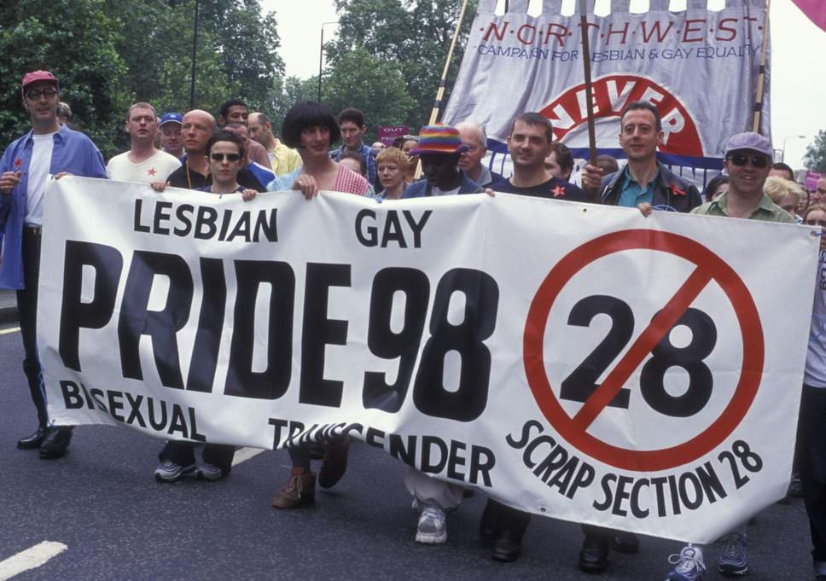
The History of LGBT+ rights in the UK
• There were mass protests by LGBT+ campaigners
• The law was stopped the United Kingdom in 2003
2003
Repeal of section 28

Slide 6
What does the law say?
Equality Act 2007 The Equality Act meant that LGB people had to be treated fairly at work and in other areas of life
Equality Act 2010 The Equality Act was updated to make sure that trans people are treated fairly
Section 89, Education Inspections Act 2006 The requirement for all schools to have preventative anti-bullying measures
Section 78, Education Act 2002 The requirement for schools to have abroad and balanced curriculum promoting the spiritual, moral, mental and physical development of pupils
New guidance on Relationships and Sex Education passed 2019 From 2020 all primary schools are required to teach about respecting different types of people and families, which may include LGBT+ families

Slide 7
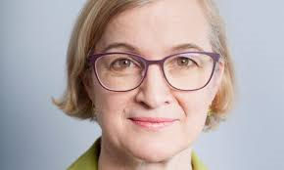
What does OFSTED say?
Amanda Spielman
(OFSTED’s Chief Inspector)
5th July 2019
People are different in so many ways. Even the youngest children notice the various dimensions of physical differences between people. Going beyond what is immediately visible, children’s families may worship differently. And families may love and marry differently too.
For young children this last part can be as simple as teaching them that some families have a mummy and a daddy, other families may have two mummies or two daddies, some may have just one parent, and some children may not live with their mummy or daddy at all.
It’s important because most children will come across same-sex couples in their young lives, and they should be able to recognise these couples as the loving families they are.
And it’s also important that children who are beginning to recognise some difference in themselves, do not assume that this makes them bad, or ill, or alone in the world.
And teach them about the wonderful diversity of humanity in modern Britain: a diversity of race, gender, faith and love. Education shouldn’t sow the seeds of discord, it should prepare the citizens of tomorrow to create a more tolerant, respectful and hopeful world.

Slide 8
What does LGBT mean?
Lesbian
Gay
Bi
Trans

Slide 9
What does LGBTQQIA+ mean?
Expanded for a more clear representation of lesbian, gay, bisexual, transgender, queer, questioning, intersex, and asexual people
There are currently more than 100 gender identities

Slide 10
Activity

Slide 11
What does LGBTQ+ inclusion look like?
Arbury Primary
My Family Tree Activity
Celebrating Differences

Slide 12
What does LGBTQ+ inclusion look like?

Slide 13
What does LGBTQ+ inclusion look like?

Slide 14
What should LGBTQ+ inclusion look like at Oakway Academy?
The history of LGBT+ rights movement
Discussion around homophobia,
biphobia and transphobia, including
impact on LGBT+ people’s
rights globally
LGBT History week 1st Feb 2020

Slide 15
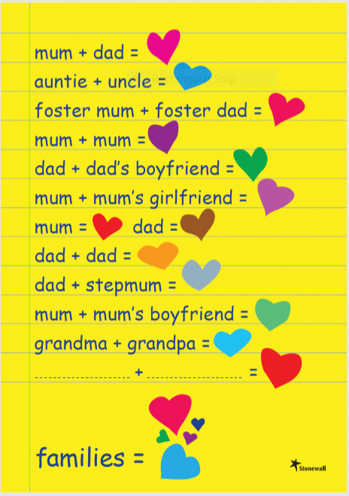
What should LGBTQ+ inclusion look like at Oakway Academy?
Reviewing materials to ensure all sexual orientations and gender identities are represented (in a sensitive, age appropriate and developmentally appropriate way)

Slide 16
Book Review

Slide 17
Video

