Slide 1
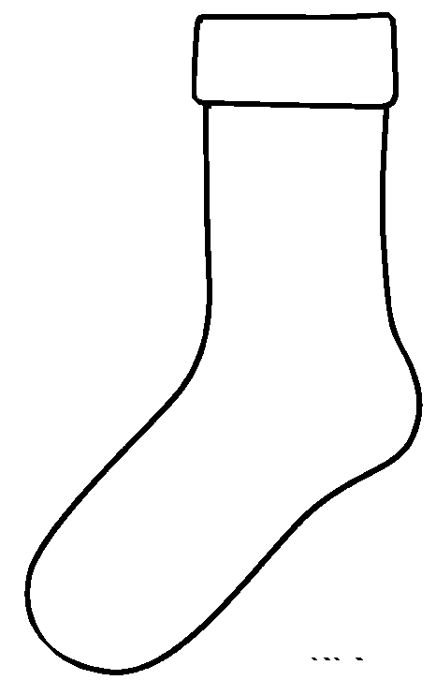
Kindness socks

Slide 2
Kindness socks (example)
RESPECT
SHARING
CARING
FUN

