Slide 1
ANTI-BULLYING WEEK 2023

Slide 2
Anti-Bullying Week 2023
Make A Noise About Bullying
Too often, we are silent when we see bullying take place, silent about the hurt bullying causes, and silent when we hear bullying dismissed as ‘just banter’.
Together, we can make a difference and take a stand against bullying.
From the playground to Parliament, and from our phones to our homes, let’s make a noise about bullying.
It doesn't have to be this way.
Of course, we won’t like everyone, and we don’t always agree, but we can choose respect and unity.
This Anti-Bullying Week let’s come together to have discussions about what bullying means to us, how banter can turn into something more hurtful, and what we can do to stop bullying.

Slide 3
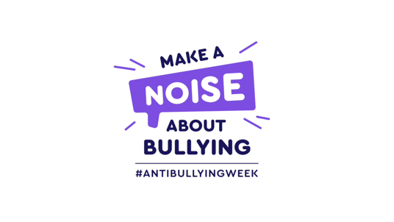
https://youtu.be/0vWCg2ElEYY

Slide 4
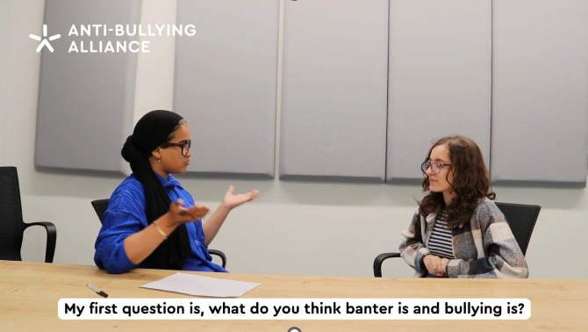
BANTER VS BULLYING
https://youtu.be/0VMYVPZVdJQ?feature=shared

Slide 5
WHAT IS BANTER?
“
Banter is the harmless exchange of social interaction between friends which involves teasing or mocking one another, either on a one-to-one basis or more commonly on a friendship group basis.
“

Slide 6
WHAT IS BULLYING?
“
The repetitive, intentional hurting of one person or group by another person or group, where the relationship involves an imbalance of power. Bullying can be physical, verbal or psychological.
It can happen face to face or online.
“

Slide 7
How banter behaviors may become bullying
https://youtu.be/cjZ-oJJB5eQ?feature=shared

Slide 8
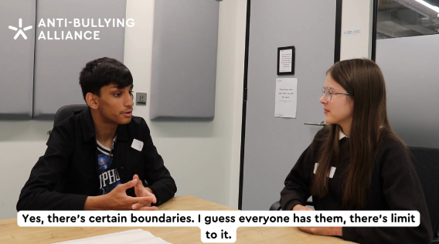
How banter behaviors may become bullying (continued)
https://youtu.be/vBxhaX8hVSE?feature=shared

Slide 9
WHEN IS BANTER ACTUALLY BULLYING?
Think before you speak. Would it be funny if someone said the same thing to you?
Don’t pick on someone's insecurities, that’s a low blow.
Be aware whether someone is clearly not enjoying the ‘banter’. If they’re not, STOP!
Don’t laugh along if you’re not finding it funny.
Saying something is ‘just banter’, doesn’t mean it is.

Slide 10
IT’S NOT BANTER IF…
You would be upset if someone said it to you.
It’s hurtful.
You’re not friends.
Someone's asked you to stop.
The target isn’t laughing.
It focuses on someone’s insecurities.

Slide 11
The different ways banter may become bullying
Topic of the Banter
The intent behind the banter
The relationship with the person
The size of the audience
Where the banter is happening
The reaction of the target
Whether the banter is repeated
Emoji use

Slide 12
How can the school community help students make a noise?
Group discussion

Slide 13
Who can you speak to at school?
Staff name here
Staff name here
Staff name here

