Slide 1
ANTI-BULLYING
WEEK 2022

Slide 2
Anti-Bullying Week 2022: Reach Out
“
Bullying affects millions of lives and can leave us feeling hopeless. But if we challenge it, we can change it. And it starts by reaching out.
It doesn’t stop with young people. From teachers to parents and influencers to politicians, we all have a part to play. Reach out to someone you trust if you need to talk. Reach out to someone if you know they’re being bullied. Reach out by being the change you want to see.
It takes courage, but it can change lives.
So, this Anti-Bullying Week, let’s come together and reach out to stop bullying.
“
Anti-Bullying Week 2022 – Reach out
2

Slide 3
Anti-Bullying Week 2022 – Reach out
3

Slide 4
What is bullying?
‘The repetitive, intentional hurting of one person or group by another person or group, where the relationship involves an imbalance of power. Bullying can be physical, verbal or psychological.
It can happen face-to-face or online.’
Anti-Bullying Week 2022 – Reach out
4

Slide 5
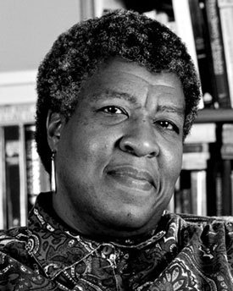
“
Discuss
Not everyone has been a bully or the victim of bullies, but everyone has seen bullying, and seeing it, has responded to it by joining in or objecting, by laughing, or keeping silent, by feeling disgusted or feeling interested.
Octavia E. Butler
“
Anti-Bullying Week 2022 – Reach out
5

Slide 6
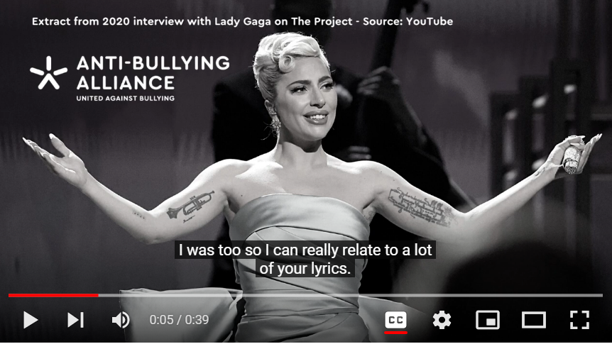
YouTube: https://youtu.be/tz_FTV3EZRM
Anti-Bullying Week 2022 – Reach out
6
This Photo by Unknown Author is licensed under CC BY-SA-NC

Slide 7
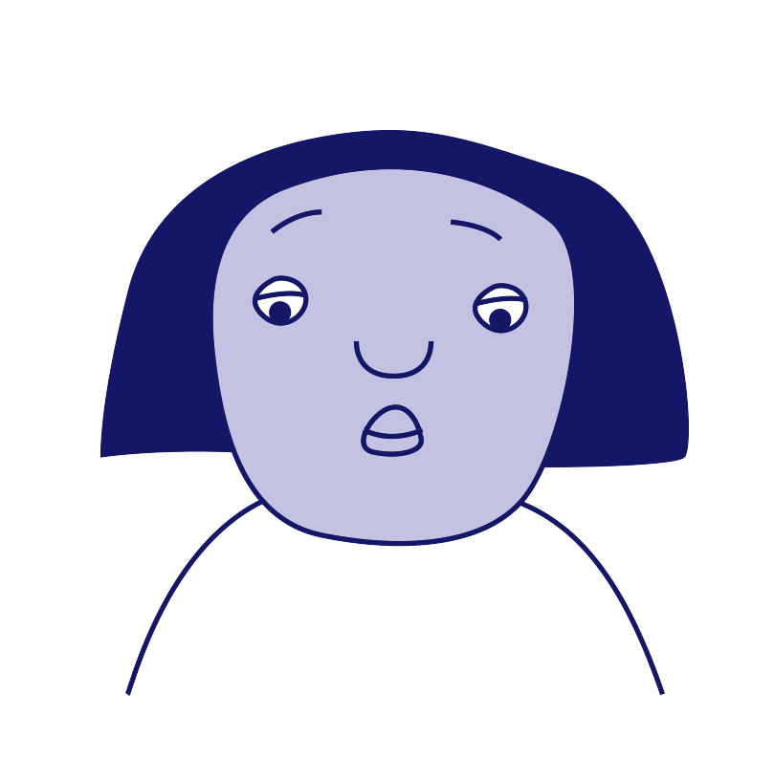
The different roles involved in bullying
‘Ringleader’
‘Target’
‘Reinforcer’
‘Outsider/
Bystander’
‘Defender’
‘Assistant’

Slide 8
How can our school community help students reach out?
Group Discussion
Anti-Bullying Week 2022 – Reach out
8

Slide 9
Who can help us in our school?
1
Staff Name here
2
Staff Name here
3
Staff Name here
Anti-Bullying Week 2022 – Reach out
9

Slide 10
Thank you for being a part of
ANTI-BULLYING
WEEK 2022

