Slide 1


ANTI-BULLYING WEEK 2026
Monday 16th to Friday 20th November

Slide 2

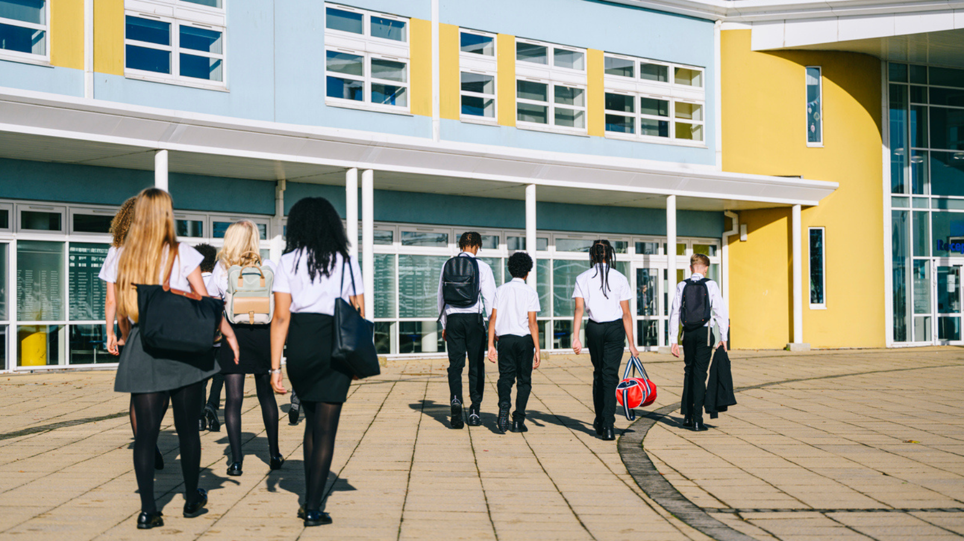
“Most people don’t like bullying - but many people stay silent when they see it happen”.
Notes:
“Most people don’t like bullying - but many people stay silent when they see it happen”.
Ask pupils to reflect quietly for a minute and then ask - why might someone stay silent?
Pupils write one reason anonymously on a Post-It note.
Collect the responses and group them together, for example:
Afraid of making things worse
Worried about becoming a target
Don't know what to say
Think it's "just banter"
Explain:
Staying silent is understandable. Many people worry about speaking up.
Today we're exploring how we can make it easier and safer to break the silence.

Slide 3
The Ripple Effect
Break the Silence
Silence
Case study 4 - Identity based
bullying:
Notes:
Display the slide with the 2 circles and ask:
Circle 1 - Silence: If nobody speaks up about bullying, what might happen next?
Examples:
Bullying continues
The person experiencing bullying feels isolated
The harmful behaviour becomes normal
Others join in
Confidence decreases
Trust reduces
Circle 2 - Break the Silence: If one person takes positive action, what could happen?
Examples:
Someone feels supported
Bullying stops sooner
Others may feel inspired to speak up
Adults become aware
Friendships strengthen
The environment feels safer
Kindness becomes more normal
Discuss how even small actions can create positive ripple effects.

Slide 4

Pupil leadership challenge
Notes:
Explain:
Anti-Bullying Week is not something adults do to pupils. It is something schools do together.
Divide into groups, and ask them to become the school's "Break the Silence Campaign Team". Their challenge is to create a campaign idea that could genuinely influence pupils.
Possible ideas:
School newsletter or website post: Create content for school comms.
Student voice project: Gather views from pupils about speaking up.
Podcast or video series: Interview pupils and staff.
Peer support initiative: Develop ways pupils can support one another.
School awareness campaign: Design posters, displays or installations
Tutor group challenge: Create weekly discussion activities.
Each group creates a one minute pitch. Class votes for the strongest idea.

Slide 5
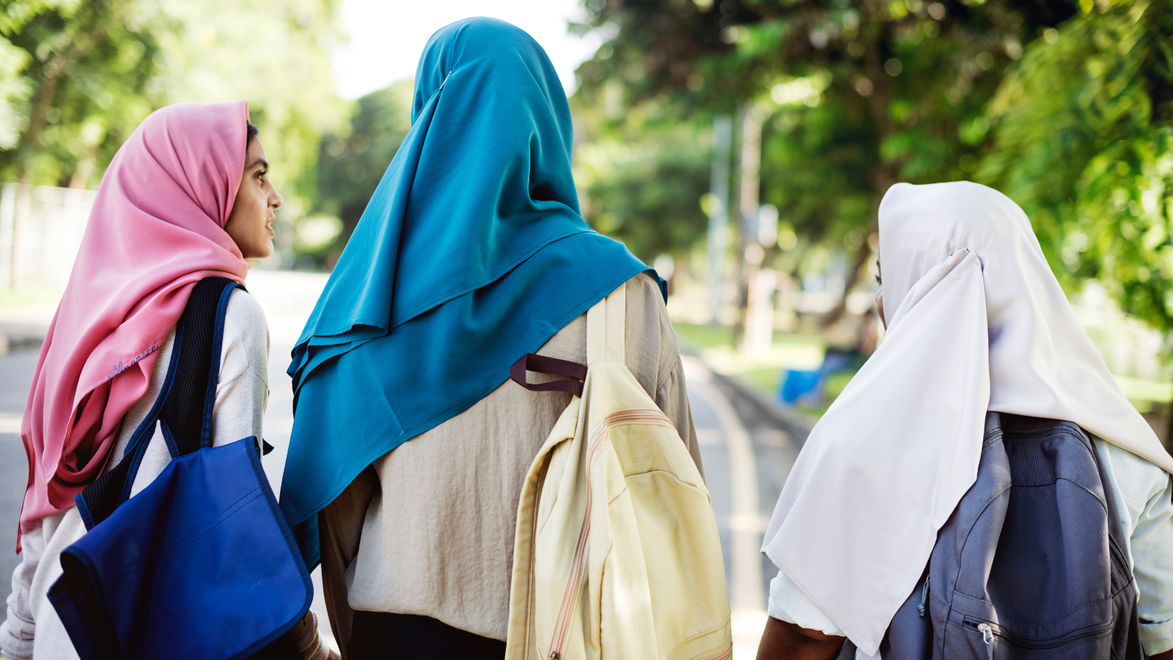
"One thing that helps young people break the silence is..."
Notes:
Display the following sentence:
"One thing that helps young people break the silence is..."
Ask pupils to write their answers anonymously on a slip of paper.
Collect responses and use them to inform future school or setting activities.
Optional: use the paper slips to create a Tree of Wishes display.

Slide 6
Breaking the Silence reflections
One thing that surprised me...
One reason people stay silent...
One way I could help break the silence...
One trusted adult I could speak to if I was worried...
Notes:
Ask pupils to complete the following sentences:
One thing that surprised me...
One reason people stay silent...
One way I could help break the silence...
One trusted adult I could speak to if I was worried...
Collect responses as they leave.

Slide 7

ANTI-BULLYING WEEK 2026
Monday 16th to Friday 20th November
Monday 16th November

