Slide 1


ANTI-BULLYING WEEK 2026
Monday 16th to Friday 20th November

Slide 2

The Invisible Line
Most people would speak up if they saw bullying
Speaking up usually makes things better
It is easier to stay silent than get involved
Reporting bullying is the same as telling tales
Young people are often worried about being judged
Schools can only tackle bullying if they know about it
Notes:
Explain that there are no right or wrong answers. Read a series of statements.
Pupils move to one side of the room for "Agree" and the other for "Disagree". Those unsure can stand in the middle.
Statements:
Most people would speak up if they saw bullying
Speaking up usually makes things better
It is easier to stay silent than get involved
Reporting bullying is the same as telling tales
Young people are often worried about being judged
Schools can only tackle bullying if they know about it
After each statement ask selected pupils to explain their reasoning. Encourage respectful debate. Explain that the lesson will explore why speaking up can sometimes be difficult.

Slide 3
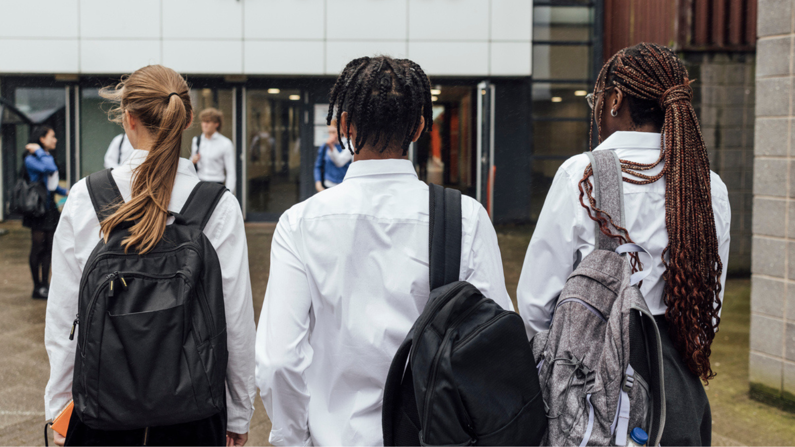
Why do people stay silent?
Notes:
Place large sheets of paper around the room with the following headings:
Fear
Embarrassment
Peer pressure
Not wanting attention
Not trusting adults
Not knowing what to do
Thinking it won't make a difference
Pupils rotate around the room. Without speaking, they write thoughts, examples, questions on Post-It notes, and attach to each heading.
After several minutes allow verbal discussion.
Ask:
Which barrier appeared most often?
Which surprised you?
Which do you think affects young people most?
Teacher summarises:
There is rarely one reason people stay silent.
People's experiences are often complicated.

Slide 4

Cast study analysis
Case study 1 - Group chat:
Case study 2 - Friendship group:
A pupil is repeatedly mocked in a group chat. Several people privately disagree with what is happening but continue to read the messages and react with laughing emojis. No one challenges the behaviour.
A friendship group begins excluding one member. People notice but justify it by saying: "We just don't get on with them anymore." The pupil becomes increasingly isolated.
Case study 3 - Appearance based
comments:
Case study 4 - Identity based
bullying:
A pupil regularly receives comments about their appearance. The comments are dismissed as jokes. The pupil stops participating in class discussions.
Pupils make repeated comments about another student's race, religion, disability, sexuality or other characteristic. Some pupils feel uncomfortable but nobody challenges it.
Notes:
Divide pupils into small groups. Give each group a different case study.
Ask the groups to discuss:
What is happening?
Who is affected?
Why might people stay silent?
What could happen if nobody speaks up?
What opportunities were missed?
How could the silence be broken safely?
Each group presents their findings.
Teacher highlights that effective responses may include:
Supporting the person affected
Challenging behaviour appropriately
Seeking help
Reporting concerns
Encouraging wider discussion

Slide 5

What does speaking up actually look like?
Notes:
Groups receive cards with possible responses:
Ignore it
Report it
Check in privately
Send a supportive message
Challenge the behaviour respectfully
Talk to a trusted adult
Encourage someone to seek help
Start a wider conversation
Groups sort responses into:
Effective
Somewhat effective
Unhelpful
Discuss why different situations may require different approaches. Reinforce that pupils are never expected to deal with serious situations alone.

Slide 6

"Silence is not always agreement. Sometimes it is uncertainty, fear or not knowing what to do."
Notes:
Ask pupils to reflect on:
What is one thing that prevents people speaking up?
What helps people feel heard?
What could our school do better?

Slide 7

ANTI-BULLYING WEEK 2026
Monday 16th to Friday 20th November
Monday 16th November

