Slide 1


ANTI-BULLYING WEEK 2026
Monday 16th to Friday 20th November

Slide 2

Have you ever seen something happen that didn't feel right, but said nothing?
Notes:
Good morning everyone.
Today marks the start of Anti-Bullying Week and this year's theme is Break the Silence
I'd like to start with a question. You don't need to answer out loud. Just think about it.
Have you ever seen something happen that didn't feel right, but said nothing?
Maybe because it felt awkward.
Maybe because you weren't sure what to do.
Maybe because you thought someone else would deal with it.
Most of us probably have.
And that is what this year's theme is about.

Slide 3


What does
'Break the Silence’
mean?
Notes:
When we hear the word bullying, many people imagine obvious situations.
But often things are much more complicated. Someone may be repeatedly excluded from a friendship group. Someone may be targeted online. Someone may be laughed at, mocked or humiliated. Someone may be struggling in silence, and nobody realises.
One of the biggest challenges is that people often do not speak up.
People stay silent because:
They are worried about making things worse
They fear being judged
They do not want to stand out
They think nobody will listen
They assume someone else will step in
The truth is that silence can sometimes allow harmful behaviour to continue.
Break the Silence means creating conversations, seeking support and helping to build a culture where people feel safe to speak up.

Slide 4
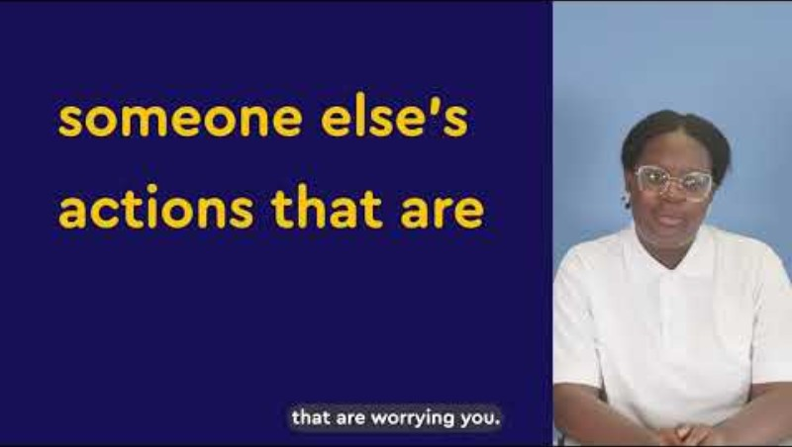
Notes:
Video link: https://youtu.be/0hjReXQpV3E

Slide 5
Which of these do you think is the biggest reason people stay silent?
1
Fear of being judged
2
Fear of making things worse
3
Peer pressure
4
Not knowing who to talk to
5
Thinking it is not serious enough
6
Believing nobody will listen
Anything else?
Notes:
Display the following statements.
Ask pupils to vote, raise hands or reflect silently.
Which of these do you think is the biggest reason people stay silent?
Fear of being judged
Fear of making things worse
Peer pressure
Not knowing who to talk to
Thinking it is not serious enough
Believing nobody will listen
Anything else?
Discuss responses.
Explain:
Many of these barriers are understandable.
But if nobody ever speaks up, people will continue struggling in silence.
Silence protects the problem, not the person.
There are many ways of breaking the silence, even a small act goes a long way.
Breaking the silence is not about confronting situations alone.
It is about recognising when support is needed and helping people access it.

Slide 6

Who has the responsibility to act when someone is being treated unfairly?
Notes:
Ask pupils:
Who has the responsibility to act when someone is being treated unfairly?
Explain:
Many people assume someone else will help. A teacher. A friend. A parent. Another pupil.
Psychologists call this the "bystander effect". The more people who witness something, the more likely it is that everyone assumes someone else will act. But positive change often begins when one person chooses to do something.
That action might be:
Checking in with someone
Reporting concerns
Challenging behaviour safely
Encouraging someone to seek support
Speaking to a trusted adult

Slide 7
This week in our school we will be having:
[school to insert relevant activities]
Notes:
This week in our school we will be having (school to insert relevant activities):
Examples:
Tutor time discussions
Student led campaigns
Awareness activities
Peer mentoring projects
Creative challenges
Fundraising or community action

Slide 8

What conversation might help someone feel less alone?

Slide 9

ANTI-BULLYING WEEK 2026
Monday 16th to Friday 20th November
Monday 16th November

Slide 10
Need support?
If you are worried about bullying or something that is happening to you or someone else, you can speak to:
Form tutor
Head of year
Designated safeguarding lead
School counsellor or wellbeing team
Peer mentors
Parent or carer
Trusted adult
[Insert school/ setting-specific support routes and reporting systems]
You do not have to deal with things on your own.

