Slide 1


ANTI-BULLYING WEEK 2026
Monday 16th to Friday 20th November

Slide 2

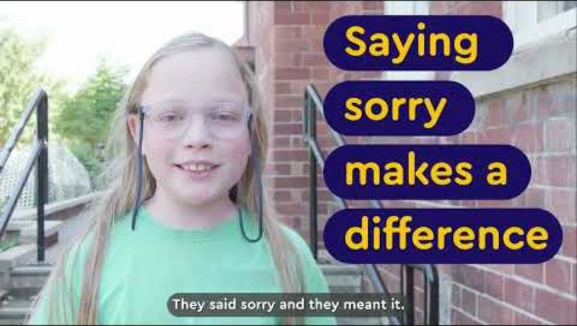
Notes:
Video link: https://youtu.be/g50MvYAyoz4

Slide 3
What is bullying?
Anti-Bullying Alliance’s definition of bullying:
The repetitive, intentional hurting of one person or group by another person or group, where the relationship involves an imbalance of power. Bullying can be physical, verbal or psychological.
It can happen face to face or online.

Slide 4
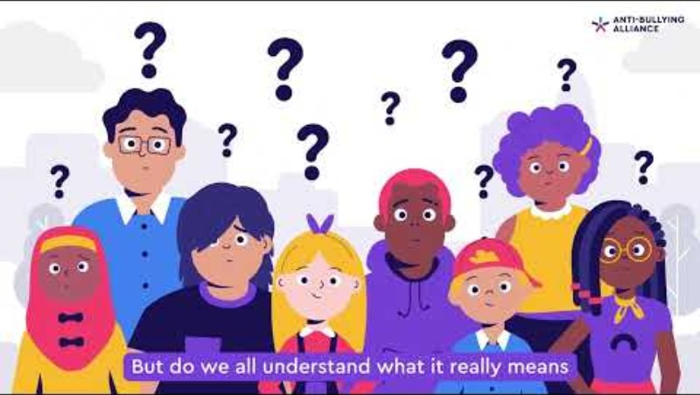

Slide 5
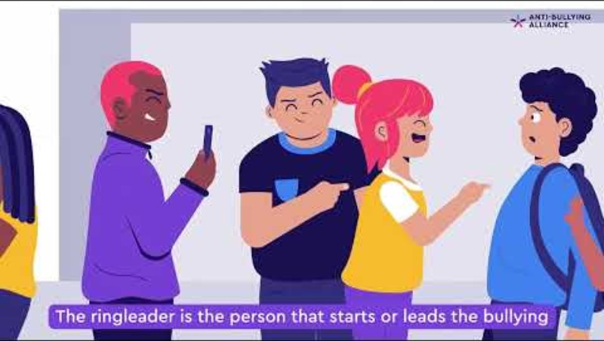

Slide 6




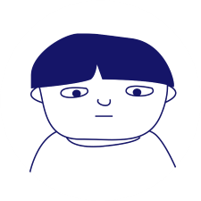

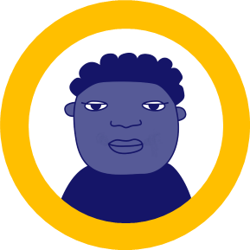

Bullying as a group behaviour
‘Ringleader’
‘Target’
‘Assistant’
‘Outsider/ Bystander’
‘Defender’
‘Reinforcer’
Notes:
Show the group the group roles video and display the slide with the roles involved in bullying.
Discuss:
Which one of the roles is the one that breaks the silence?
What are the ways in which Defenders can break the silence?
How can we encourage Bystanders and Outsiders to also break the silence?
Remind the group that there are many ways to break the silence, including speaking to a trusted adult about what has happened and checking in on the person targeted.
Every action counts and helps, no matter how small.

Slide 7

The ripple effect
Notes:
Show a picture of a pebble creating ripples in water.
Ask:
What happens when one small pebble lands in water?
Discuss how one small action can spread out and affect many people.
Provide pupils with a “Ripple of Change” template (Handout 3).
Ask them to complete the different sections, and share their ripples with others.
Display ripples together to create a class or school "Our Ripples of Change" display.

Slide 8
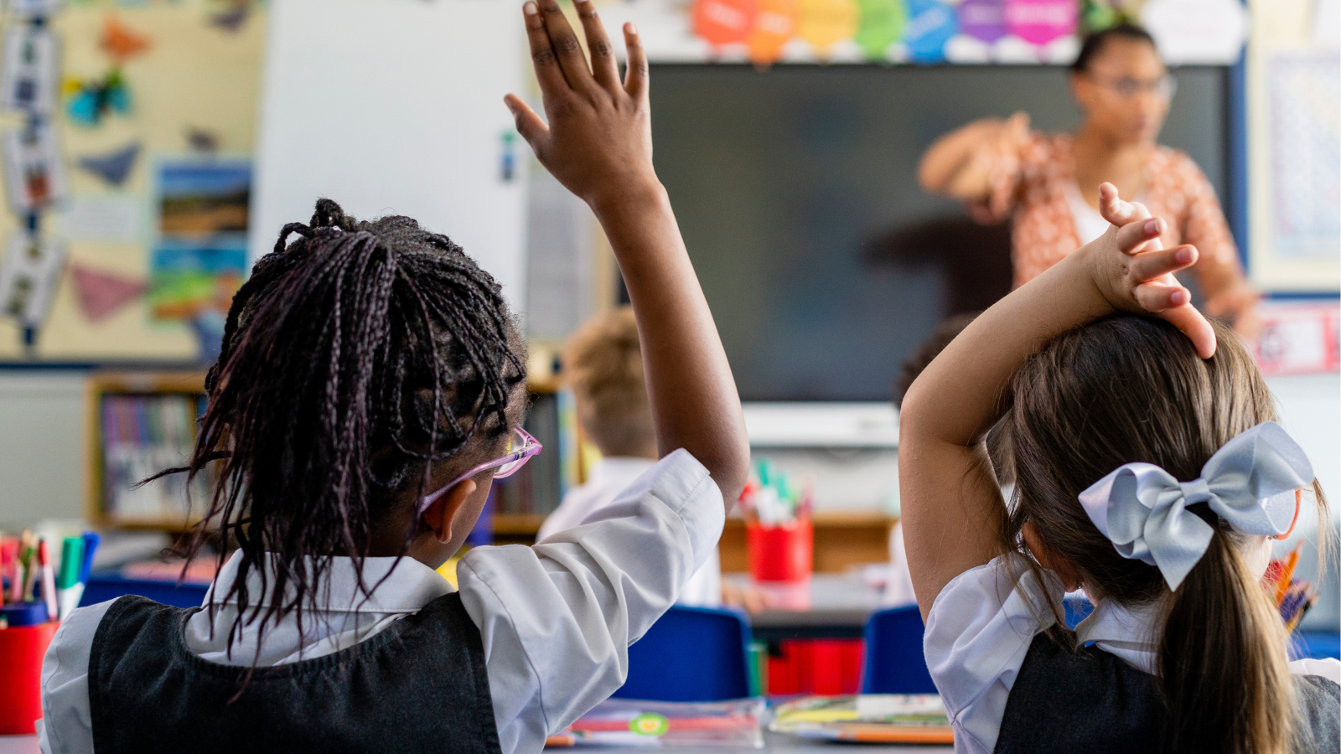
"When I break the silence, I… "
Notes:
Ask pupils to complete the sentence:
“When I break the silence, I...”
Examples:
...help prevent bullying.
...support people who feel excluded.
...feel empowered to speak up.
...inspire others to do the same.
...am a defender and not a bystander.

Slide 9

ANTI-BULLYING WEEK 2026
Monday 16th to Friday 20th November
Monday 16th November

