Slide 1


ANTI-BULLYING WEEK 2026
Monday 16th to Friday 20th November

Slide 2


Activity
Sound of Silence
Notes:
Ask pupils to sit quietly for 20 seconds.
After the silence, ask:
What did you notice?
How did the silence feel?
Was it comfortable or uncomfortable?
Why do people sometimes stay silent?
Explain:
Sometimes people stay silent because they are worried, embarrassed, scared, confused or unsure what to do. Today we are going to explore how we can break the silence when someone needs support.

Slide 3
Interactive discussion
1
I don't want to get involved
2
Nobody will listen
3
I might make things worse
4
It's not my business
5
I don't know what to say
6
I don't want people to laugh at me
Notes:
Display the following statements around the room:
I don't want to get involved
Nobody will listen
I might make things worse
It's not my business
I don't know what to say
I don't want people to laugh at me
Read each statement aloud. Ask pupils to move to the statement they think might describe what would stop someone from speaking up.
Discuss:
Why might someone feel this way?
What could help them feel more confident?

Slide 4
Cast study detectives
Case study 1
Case study 2
Mia loves football but every lunchtime some children tell her she cannot play because she is not good enough. Other children hear these comments but nobody says anything.
Jay keeps being laughed at because of the clothes he wears. A few children think it is unfair, but they stay quiet because they do not want attention drawn to themselves.
Case study 3
Case study 4
A group chat has been created without Aisha. Some children know she has been left out but nobody mentions it.
Sam is often interrupted and laughed at when he answers questions in class. People notice but assume somebody else will help.
Notes:
Divide pupils into small groups. Give each group a different case study.
Groups discuss:
What is happening?
How might the child feel?
Why might people stay silent?
What could happen if nobody speaks up?
In what ways can you ‘break the silence’?
Feedback to class. Teacher highlights that breaking the silence can involve:
Supporting someone
Including someone
Challenging behaviour safely
Reporting concerns
Speaking to a trusted adult

Slide 5


Rewrite the ending
Ending 1:
Silence
Ending 2:
Break the Silence
Nobody does anything. What happens next?
Someone speaks up.
What changes?
Notes:
Every story can have more than one ending. Reshuffle the case studies so that each group gets a new one. Their challenge is to create two endings for each case study.
Ending one: Silence
Nobody does anything. What happens next?
Ending two: Break the Silence
Someone speaks up. What changes?
Groups can present through:
Role play
Freeze frame
Comic strip
Short narration
Just explaining
After each presentation ask:
Which ending would you rather experience?
What difference did speaking up make?

Slide 6
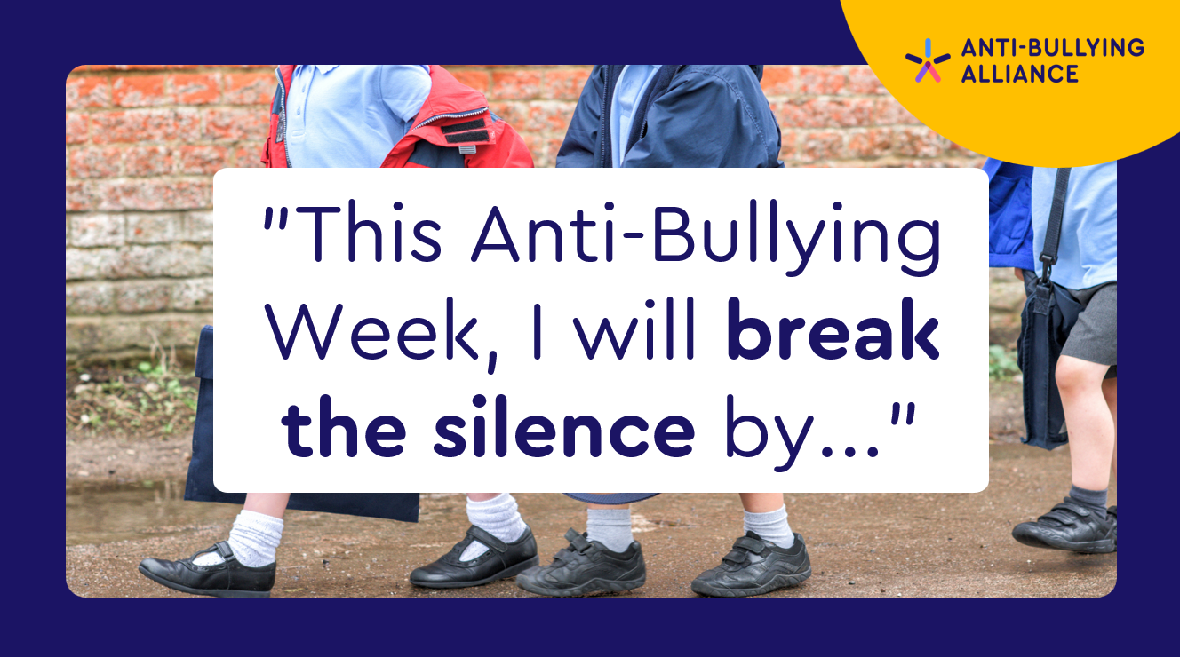

"This Anti-Bullying Week, I will break the silence by..."
Notes:
Ask pupils to complete the sentence:
"This Anti-Bullying Week, I will break the silence by..."
Examples:
Including someone
Speaking kindly
Asking for help
Supporting a friend
Listening carefully
Telling a trusted adult if I am worried

Slide 7
What is bullying?
Anti-Bullying Alliance’s definition of bullying:
The repetitive, intentional hurting of one person or group by another person or group, where the relationship involves an imbalance of power. Bullying can be physical, verbal or psychological.
It can happen face to face or online.

Slide 8

ANTI-BULLYING WEEK 2026
Monday 16th to Friday 20th November
Monday 16th November

