Slide 1


ANTI-BULLYING WEEK 2026
Monday 16th to Friday 20th November

Slide 2

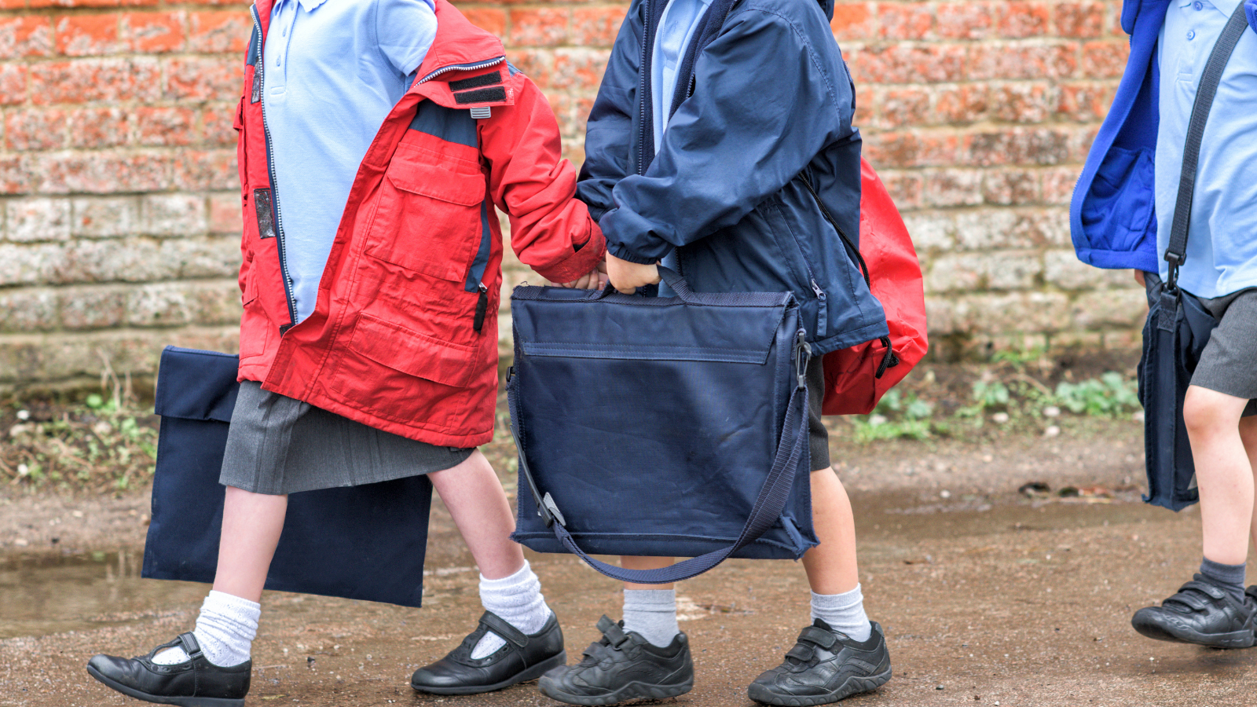
What does
'Break the Silence’
mean?
Notes:
Let's start with a quick show of hands. Why do you think people sometimes stay silent when something is wrong?
Take responses from pupils.
Possible answers:
They feel nervous
They feel embarrassed
They don't want to get someone into trouble
They think nobody will listen
They don't know who to talk to
Thank pupils for their ideas.
Explain:
Sometimes when bullying happens, people stay silent. The person being bullied might stay silent because they feel worried or upset.
Someone who sees bullying might stay silent because they don't know what to do.
Even adults sometimes stay silent because they are not sure how to help.
But when we break the silence by talking, listening and supporting one another, positive things can happen.
Breaking the silence doesn't mean shouting or arguing.
It means speaking up, asking for help, supporting others and starting important conversations.

Slide 3
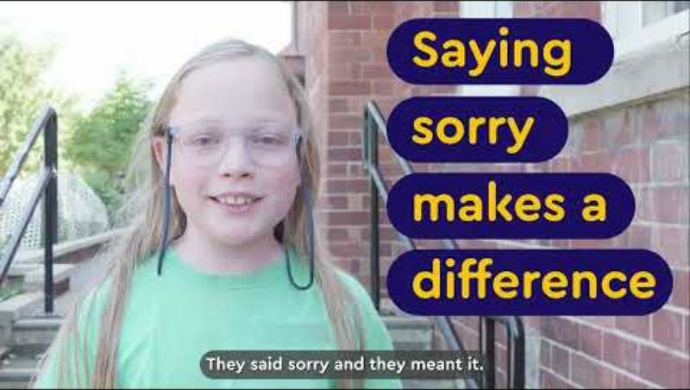
Notes:
Video link: https://youtu.be/g50MvYAyoz4

Slide 4

What would you do?
Notes:
Tell pupils: I’m going to read out some examples of scenarios.
If you think someone should speak up, put your hand on your head.

Slide 5
Breaking the Silence scenarios
1
Someone is being left out of a game every day.
2
You hear somebody calling another child hurtful names.
3
A friend tells you they are worried about how someone is treating - them.
4
You notice someone sitting alone looking upset at lunchtime.
Notes:
After each scenario ask:
Who could help?
What could somebody say?
What could somebody do?
Reinforce that pupils are not expected to solve problems on their own.
Talking to trusted adults is an important way of breaking the silence.

Slide 6

What's happening this week?
Notes:
Use this slide and tell pupils what your school or setting plans to do for Anti-Bullying week.
Examples:
Taking part in Break the Silence lessons
Creating a Break the Silence display
Making pledges about kindness and respect
Exploring how we can support one another
Sharing ideas in class discussions
Throughout the week we will be thinking about how every member of our school community can help make sure nobody feels alone.

Slide 7
Our Anti-Bullying Week pledge
When we see something wrong, we won't ignore it.
When someone needs support, we will help them find it.
When we are worried, we will speak to someone we trust.
Together, we will Break the Silence.
Notes:
(Pledge will appear on click)
Ask pupils: Turn to the person next to you and share one thing you could do this week to help break the silence.
Allow 30 seconds discussion.
Bring pupils back together.
Emphasise: This Anti-Bullying Week, remember that your voice matters.
You can break the silence by:
Speaking up when something is wrong
Supporting someone who needs help
Listening when somebody wants to talk
Talking to a trusted adult if you are worried.
Together we can create a school where everyone feels safe, valued, respected and heard.
Let’s finish with our Anti-Bullying Week pledge (display the pledge)

Slide 8

ANTI-BULLYING WEEK 2026
Monday 16th to Friday 20th November
Monday 16th November

